Slide 1


Wireless Capsule Endoscopy Image Analysis
Module: SIVO
Proposed by:
Pr BEGHDADI Azeddine
Implemented by :
M. SEKKAI Samy
Mars 21st, 2023

Slide 2
Outline
Introduction
Context
Objective
Part1
Literature Review
Conclusion
Selected Architecture
Training and Results
Part 2
Caracteristics of the application
User Interface
Summary
Limitation
Perspectives

Slide 3
Context
Definition
Wireless Capsule video endoscopy(WCE) is an appealing alternative to traditional diagnostic techniques, since it allows inspection of the gastrointestinal tract without discomfort to the patient or need for sedation,
The data can be visualised as images or videos on the monitor of the physicians. Capsule endoscopy helps visualise section of the small intestine that cannot easily be seen or reached with traditional endoscopic procedures.
Recommended for the diagnosis of Gi tract conditions such as Crohn’s disease, Ulcerative colitis, Tumours, Polyps, Ulcers, Unexplained GI bleeding, etc.
However
WCE produces a huge amount of images ( 50000 ~ 60000)*.
Visualizing this amount of data for a diagnosis is time consuming process;
Probability of missing an information during the screening process leading to wrong diagnosis.
There is a need for a solution to help in diagnostics process.
* Muruganantham, P., & Balakrishnan, S. M. (2021). A survey on deep learning models for wireless capsule endoscopy image analysis. International Journal of Cognitive Computing in Engineering, 2, 83-92

Slide 4
Objective
Developed a solution that helps screening medical images generated by WCE, and provide diagnosis. This project is divided in two parts :
The development of a tool, based on deep learning, to detect images containing anomalies (we will limit ourselves to a few).
The development of a graphical interface that allows the visualization of images in an intelligent way to facilitate the exploration of anomalies.

Slide 5

Part 1
WCE Images Classification

Slide 6
Literature Review
Machine learning and Deep learning models are used for image classification.
Recent methods are based on deep learning architecture because they are able to capture and extract high level semantic information.
In a survey study made by [1] on medical image analysis, they found that studies on classification
Models mostly based on CNN architecture.
They used custom datasets which makes it difficult to reproduce the performance of their models.
Studies focus mostly on detecting a specific abnormality such as bleeding or polyps .
A recent study[2] compared deep learning models for anomaly classification of Gastrointestinal Tract.
Trained state of the art architectures ,
used K-vasir dataset with augmentation
VGG16 and Xception architecture showed best performance (98,275%, 98,324%)
[1] Muruganantham, P., & Balakrishnan, S. M. (2021). A survey on deep learning models for wireless capsule endoscopy image analysis. International Journal of Cognitive Computing in Engineering, 2, 83-92
[2] Dheir, I. M., & Abu-Naser, S. S. (2022). Classification of anomalies in gastrointestinal tract using deep learning..

Slide 7
Selected Architectures
VGG16, VGG19, XCEPTION

Slide 8
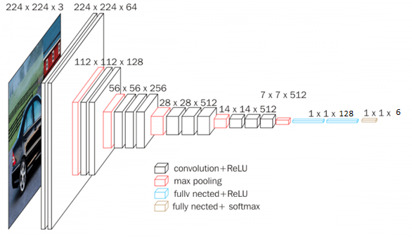
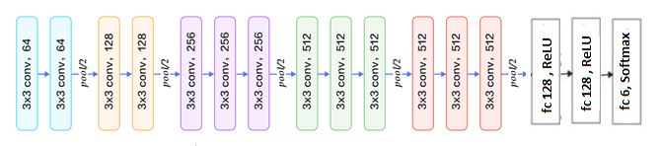
VGG16
16 layers with weights (i.e learnable parameters layers).
13 convolutional layers,
5 Max Pooling layers,
3 Dense layers
The Input is an image tensor of size (224, 224) with 3 RGB channels
added layers
Fully connected( 128) with ReLu activation function,
Fully connected( 128 )with ReLu activation function
Fully connected( 6 )with softmax activation function
Added layers
Leonardo, M. M., Carvalho, T. J., Rezende, E., Zucchi, R., & Faria, F. A. (2018, October). Deep feature-based classifiers for fruit fly identification (Diptera: Tephritidae). In 2018 31st SIBGRAPI conference on graphics, patterns and images (SIBGRAPI) (pp. 41-47). IEEE.

Slide 9
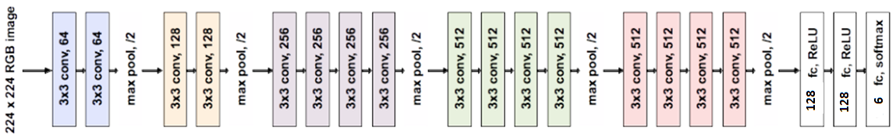
VGG19
Added layers
Architecture is similar to the one of VGG16;
Difference in number of layers in convolutional blocs.
While VGG16 has 3 layers in the Bloc 3, 4 and 5, VGG19 comes with 4 layers
19 learnable layers(with weights).
added layers
Fully connected( 128) with ReLu activation function,
Fully connected( 128 )with ReLu activation function
Fully connected( 6 )with softmax activation function
Leonardo, M. M., Carvalho, T. J., Rezende, E., Zucchi, R., & Faria, F. A. (2018, October). Deep feature-based classifiers for fruit fly identification (Diptera: Tephritidae). In 2018 31st SIBGRAPI conference on graphics, patterns and images (SIBGRAPI) (pp. 41-47). IEEE.

Slide 10
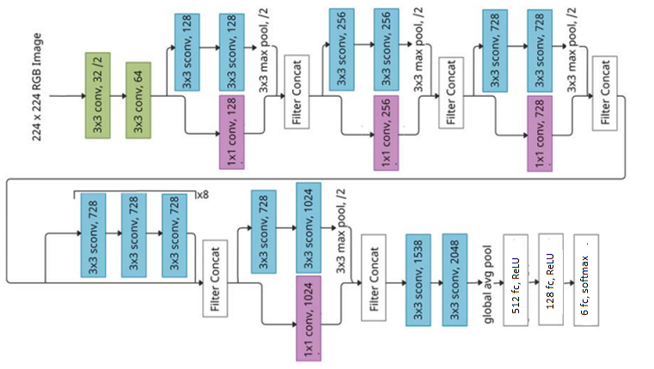
Xception(Extreme Inception )
36 convolution layers that enable feature extraction.
The layers are structured in 14 modules (one module is repeated eight times),
Except the first and last one, all modules have linear direct connections to one another.
added layers
Fully connected( 512) with ReLu activation function,
Fully connected( 128 )with ReLu activation function
Fully connected( 6 )with softwmax activation function
Added layers
Leonardo, M. M., Carvalho, T. J., Rezende, E., Zucchi, R., & Faria, F. A. (2018, October). Deep feature-based classifiers for fruit fly identification (Diptera: Tephritidae). In 2018 31st SIBGRAPI conference on graphics, patterns and images (SIBGRAPI) (pp. 41-47). IEEE.

Slide 11
Training and Tests Results

Slide 12
Dataset
Source: hyper-kvasir, kvasirV2, and kvasir-Capsule.
Anatomical Landmarks: recognizable feature within the GI tract they are “Cecum”, “Z_line”, “and Pylorus”
Pathological finding: is abnormal feature within the gastrointestinal tract. Pathologies are “Esophagitis”, “Polyps”, and “Ulcerative Colitis”
Final dataset:
9600 images (1600 for each class)
Classes(06):
Normal: “Cecum”, “Z_line”, “and Pylorus”.
Abnormal: “Esophagitis”, “Polyps”, and “Ulcerative Colitis”.
Split : 80:10:10
Data | Sample per class | Total
Train | 1200 | 7200
Validation | 200 | 1200
Test | 200 | 1200

Slide 13






Tools and Libraries

Slide 14
Evaluation Metrics
Accuracy : Model accuracy is defined as the number of classifications a model correctly predicts divided by the total number of predictions made. It’s a way of assessing the performance of a model.
Precision : Attempts to answer the following question : What proportion of prediction as positive was actually correct?
Recall: Attempts to answer the following question: What proportion of actual positives was identified correctly?
Importance of the metrics:
All classes have the same importance : Accuracy is enough to evaluate the model’s performance
Different importance (Abnormal images in our project): Precision and recall are used as reference.
The best model must have a perfect precision and recall
https://developers.google.com/machine-learning/crash-course/classification/precision-and-recall

Slide 15
Performances table of the models
Model | Train |  |  | Validation |  |  | Test
Metrics | Acc | Pre | Rec | Acc | Pre | Rec | Acc | Pre | Rec
VGG16 | 0.951 | 0.949 | 0.952 | 0.853 | 0.852 | 0.856 | 0.853 | 0.856 | 0.85
VGG19 | 0.998 | 0.998 | 0.998 | 0.857 | 0.856 | 0.858 | 0.852 | 0.855 | 0.85
Xception | 0.997 | 0.997 | 0.997 | 0.882 | 0.881 | 0.883 | 0.882 | 0.881 | 0.883
Xception has better performances than VGG16 and VGG19

Slide 16
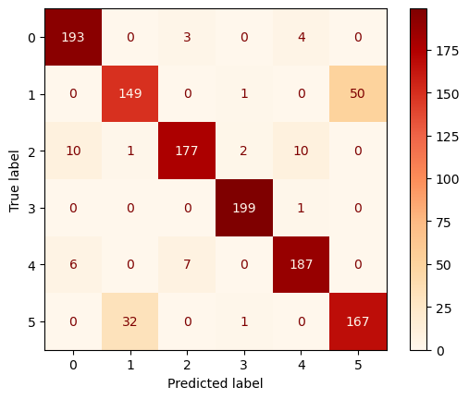
Performance of Xception by Class
Cecum and Pylorus show the highest values for Recall and Precision
Model is able to classify almost all the sample images of the two classes correctly(Recall).
At the same time, it has low confusion with other classes, 92% of images classified as Cecum were Cecum, and 99% of the images classified as Pylorus were Pylorus images(Precision).
Only one Pylorus sample was misclassified as Ulcerative_colitis.
The model has the highest confusion between Z_line and Esophagitis.
16% of Z_line images are misclassified as Esophagitis,
25% of Esophagitis are misclassified as Z_line.
25% of Esophagitis anomaly are not Detected.
Class(Normal,Abnormal) |  | Precision | Recall
Cecum | 0 | 0.92 | 0.96
Esophagitis | 1 | 0 .82 | 0.74
Polyp | 2 | 0.95 | 0.88
Pylorus | 3 | 0.98 | 0.99
Ulcerative_colitis | 4 | 0.93 | 0.94
Z_Line | 5 | 0.77 | 0.84
It is more risky to have abnormal image misclassified as normal than having normal misclassified as abnormal

Slide 17
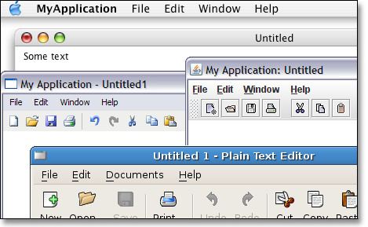
Part 2
Image visualization application

Slide 18
Characteristics of the application
Allows exploration of Medical images in an intelligent way.
WCE images are automatically classified to normal and abnormal classes by inference to the Xception model.
Images processing functions are implemented.
Zoom: [0.25, 0.5, 0.66, 0.75, 1, 2,3,4]
Rotation with an angle to be defined,
Horizontal and vertical flip
Gray scale
Brightness/Contrast,
Image slideshow: images in a folder are displayed in a slideshow
Edge detection: Sobel, Canny, and Laplacian algorithms.

Slide 19




Tools and Libraries

Slide 20
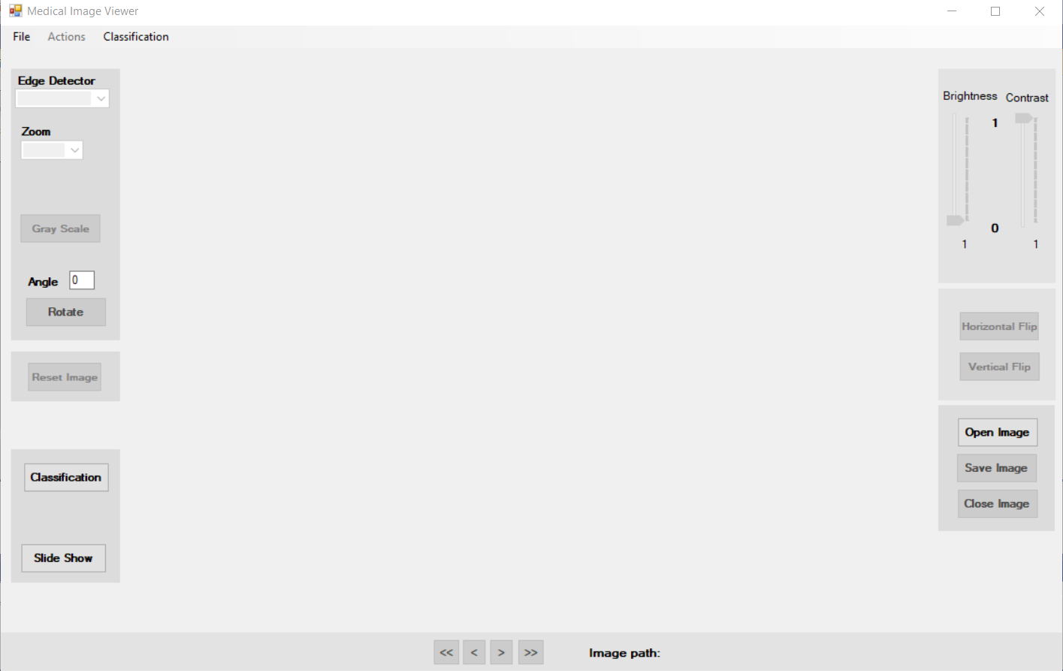
User Interface: Main Form

Slide 21
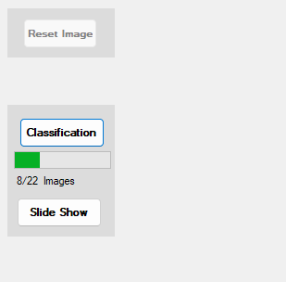
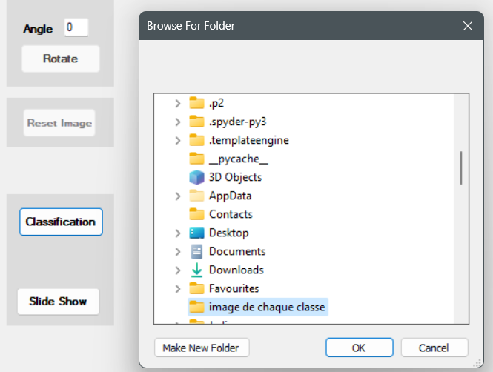
Classification inference

Slide 22
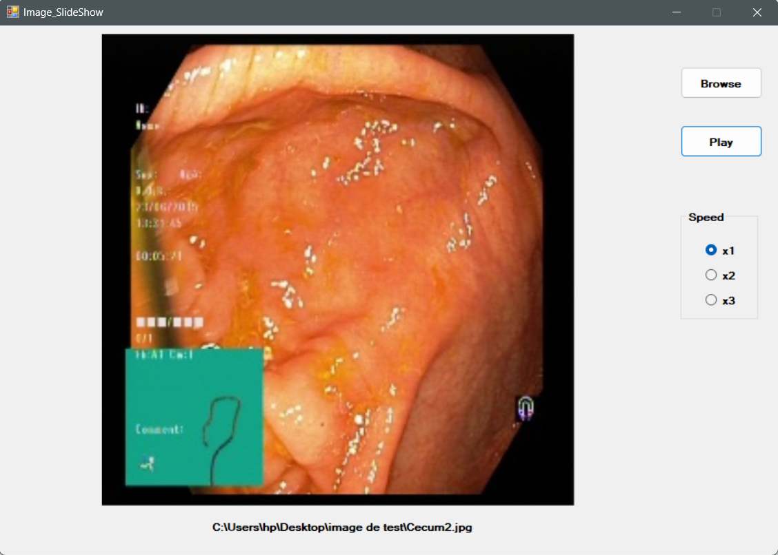
Visualise Images in slideShow

Slide 23
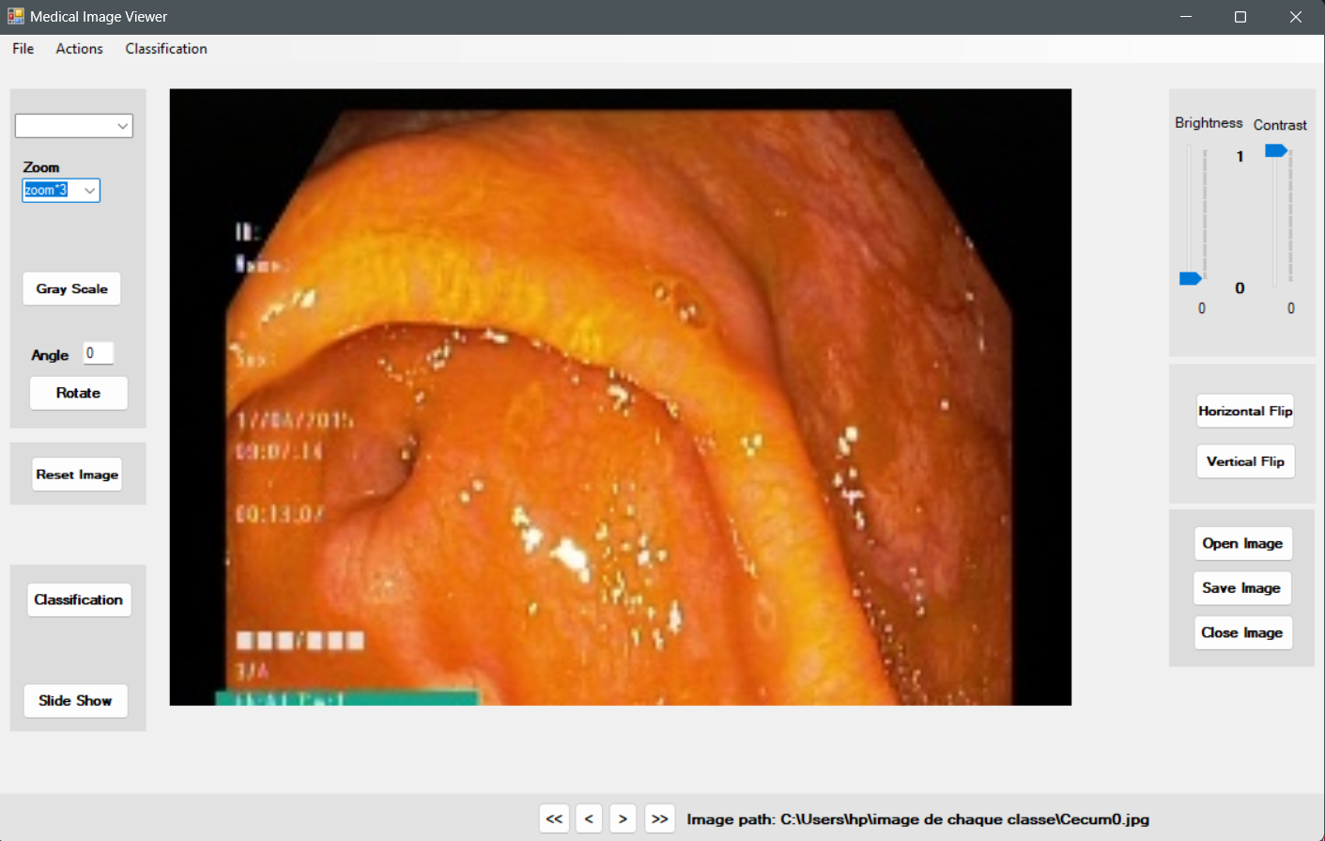
Image Processing
Zoom*3

Slide 24
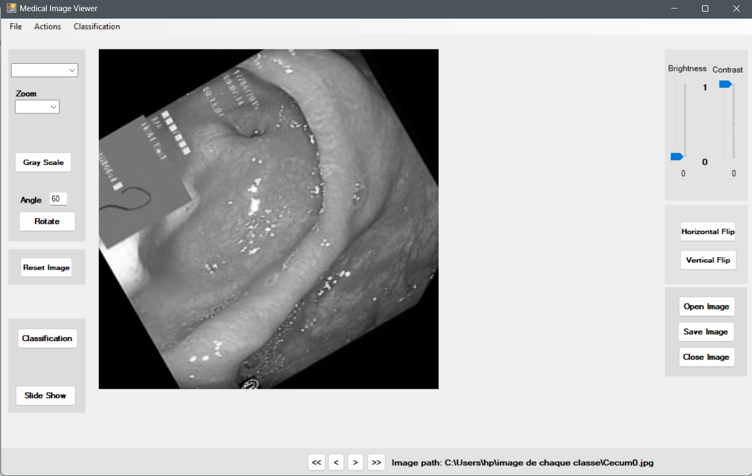
Image Processing…
Zoom*2
Rotation 60°
Gray Scale

Slide 25
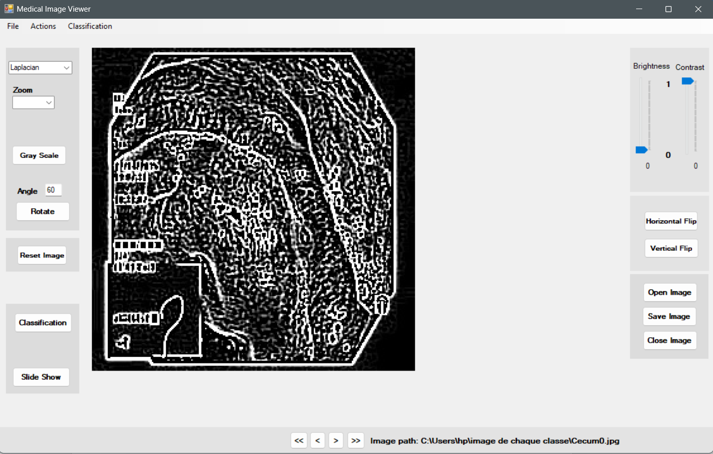
Image Processing…
Zoom*2
Laplacien filter

Slide 26
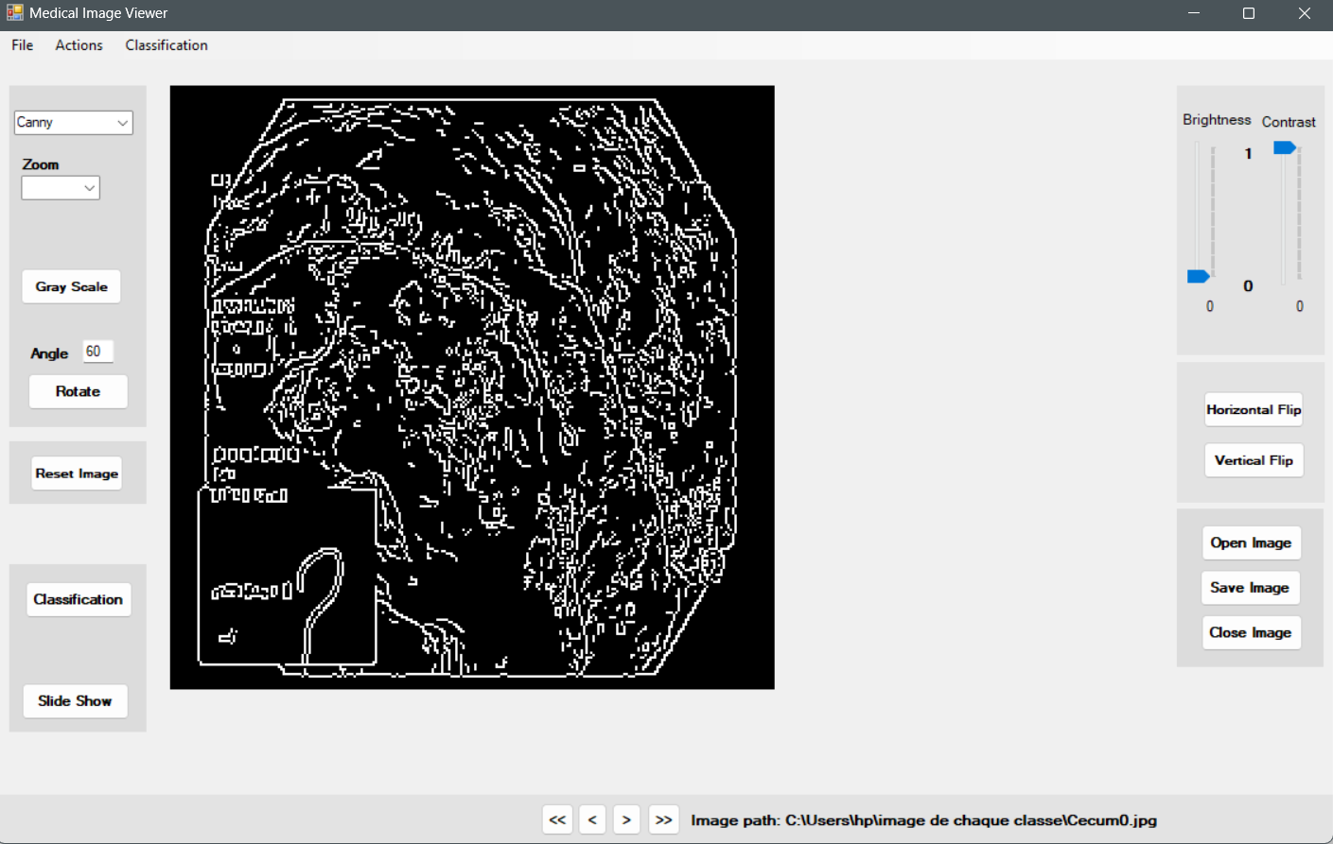
Image Processing…
Zoom*2
Canny filter

Slide 27
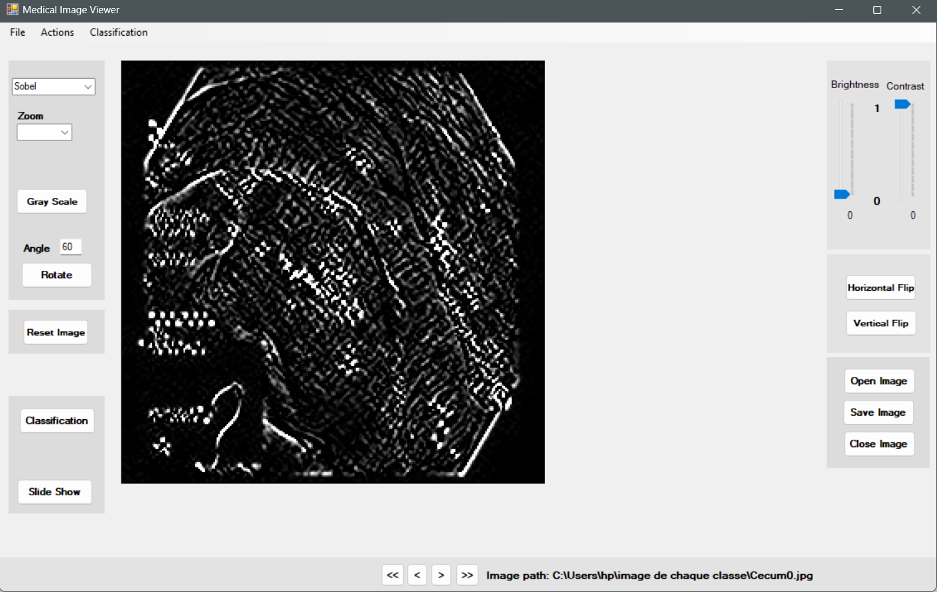
Image Processing…
Zoom*2
Sobel filter

Slide 28

Conclusion

Slide 29
Summary
Developed an application that allows a medical practitioner to visualize in an intelligent way wireless capsule endoscopic images and easily manipulate them, to help defining a diagnosis.
The developed solution, allows the classification of images from Gastrointestinal tract and classify them as normal (“Cecum” , “Z_line”, and “Pylorus”.) or abnormal(“Polyps” , “Esophagitis”, and “Ulcerative_colitis).
The application also allows to visualise images as slideshow, or manipulate a single image and apply several filters and functions on it.
What I learned throughout the project
Appy AI and deep learning in real problems,
Comparing performances using metrics,
Development of Application,
Image processing,
Work with multiple libraries and languages.

Slide 30
Limitations
Trained Xception model has high confusion for some classes(Z_Line & Esophagitis).
The Size of the dataset was not large( 9600 images) which affect learning performance of the model.
Because of time limitation, the problem was not addressed.
For the image visualisation application, I implemented the common image processing functions, other useful functions and filters could be more adequate for medical field.

Slide 31
Perspectives
Increase dataset size using data augmentation techniques,
Refer to a Medical practitioner for advice on what is needed in this application as functions, filters as well as user interface.

Slide 32

Thank You
Q&A

